Slide 1
Topic: Substitution
EQ: How do we substitute into expressions?
Ms. Latham

Slide 2
Topic: Substitution
EQ: How do we substitute into expressions?
The variables (a,b,x,y…etc…) are ‘place holders’ for a number
What are the variables?
2x – 1 if x=3
Rewrite the expression replacing the variable with the number
Use Order of Operations (BIMDAS) to solve
Rewrite the expression after each step (this part is how you show your work for full marks during the test)
Show your final answer clearly
2x – 1
2×3 – 1
Steps to solve
Multiplication first 2×3 = 6
6 – 1 = 5
x= 5
Try these for x=4 and y = 2
5x-2y 3x²-5 3x÷2 + y

Slide 3
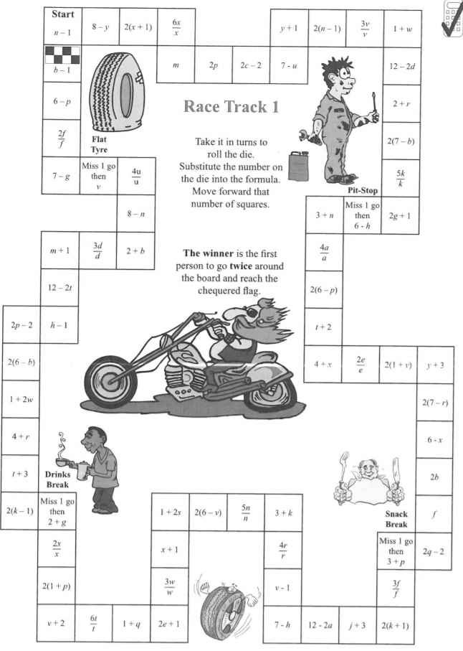
Race track substitution - in pairs - roll dice and substitute the value into the equation - move forward that number of squares

Slide 4
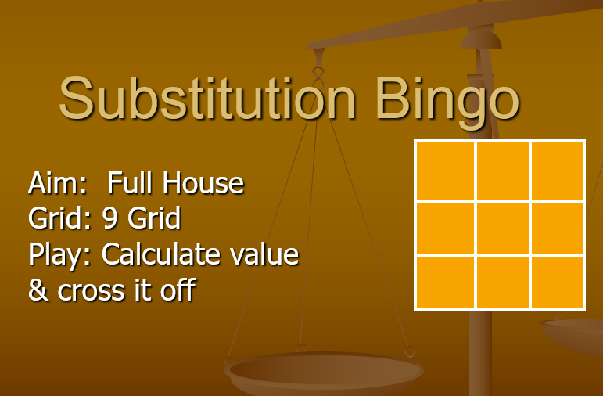
Make a 3 by 3 grid
Conclusion

